Slide 1
How can be improved the Saber 11 results in Colombia?
Data results from years: 2018, 2019 y 2020
Date: August 2022
Google data analytics capstone - Case study
Fabian Enrique Pedreros Camargo

Slide 2
Agenda
1. Introduction (5 minutes)
2. Project overview and goals (5 minutes)
3. Data and analysis (10 minutes)
4. Recommendation (3 minutes)
5. Further exploration (2 minutes)
6. Questions (5 minutes)

Slide 3
1. Introduction
We are going to work with the results of a exam done in Colombia called Saber 11 between 2018 and 2020, and some demographic information about the students.
The Saber 11, popularly known as ICFES, is a high school exit exam administered annually in grade 11. The purpose of the exam is to evaluate students' aptitude in five subjects: critical reading, mathematics, social studies, science and English.
The Saber 11 exam scores students using an overall score ranging from 1 to 500 points, while the score for each subject ranges from 1 to 100 points.

Slide 4
2. Project overview and goals
The Saber 11 is an important measure for the education quality, how Saber 11 results can be improved in Colombia?
To answer the main question it is necessary to divide it into more specific questions.
How are the results in the five subjects?
Are there any subjects in which students perform worse?
Are there differences in the overall results that can be explained by demographic variables?
What demographic groups should be prioritized in the improvement of education in order to obtain better overall Saber 11 scores?
What policies can be suggested in order to improve the global score?

Slide 5
3. Data analysis
What about stratum? →
Social sciences, Natural Sciences and English have the lowest mean scores.
Lowest results
Notes:
The subjects in which students obtained the worst average results during 2018, 2019 and 2020 were Social Sciences, English and Natural Sciences with their corresponding average scores of 48.25, 49.67 and 49.48.

Slide 6
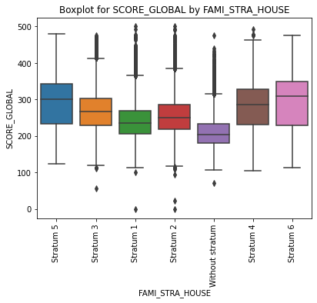
3. Data analysis
What about fathers education? →
Demographic variable: Stratum
The lower strata have lower mean scores than the higher strata.
Worst performance:
Without stratum with a mean score of 210.94
Stratum 1 with a mean score of 238.66
Stratum 2 with a mean score of 252.68
Lowest results
Notes:
As the social stratum increases, so does the global score obtained, for example, we can see how the average score of students in stratum one is 238.66, while those in stratum 6 obtain 291.47 points. The three subgroups with the worst performance from the lowest to the highest are:
Without stratum, with a mean score of 210.94
Stratum 1, with a mean score of 238.66
Stratum 2, with a mean score of 252.68

Slide 7
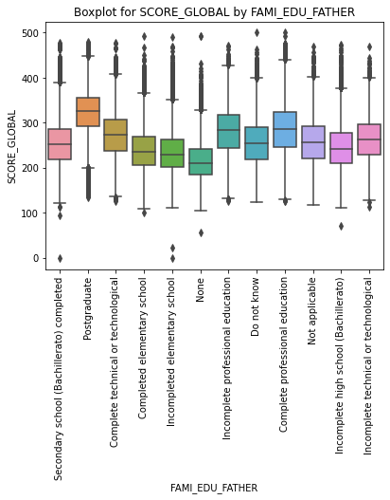
3. Data analysis
What about mothers education? →
Demographic variable: Father Education Level
The student's total score can be explained by the maximum educational level attained by the father, and it is observed that the higher the educational level, the better the results.
Worst performance:
None with a mean score of 215.76
Incomplete elementary school with a mean score of 233.73
Completed elementary school with a mean score of 238.89
Lowest results
Lowest results
Notes:
The student's total score can be explained by the maximum educational level attained by the father, and it is observed that the higher the educational level, the better the results. Students whose father has no education have an average score of 215.76, while those who finished high school have an average score of 253.0 and those who are the children of professionals with postgraduate degrees have an average score of 320.44.

Slide 8
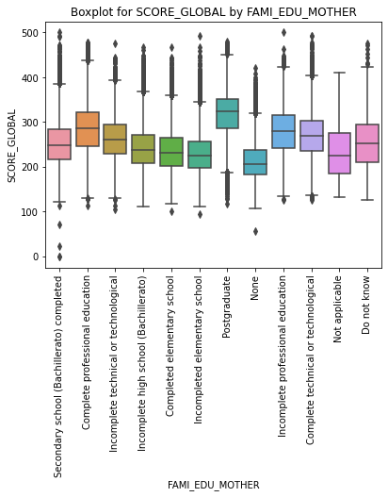
3. Data analysis
What about journey? →
Demographic variable: Mother Education Level
The student's total score can be explained by the maximum educational level attained by the mother, and it is observed that the higher the educational level, the better the results.
Worst performance:
None with a mean score of 212.30
Incomplete elementary school with a mean score of 229.24
Completed elementary school with a mean score of 235.1
Lowest results
Notes:
The student's total score can be explained by the maximum educational level attained by the mother, the higher the educational level, the better the results. Students whose mother has no education have an average score of 212.30, while those who finished high school have an average score of 250.0 and those who are children of professionals with graduate degrees have an average score of 315.7 It appears that there is a higher correlation between student scores with the educational level of the mother than with the educational level of the father. However, the data are not as strong.

Slide 9
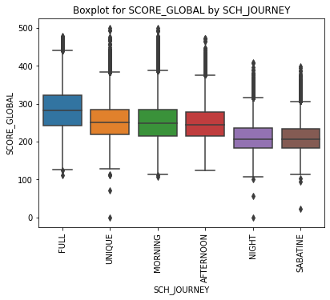
3. Data analysis
What about having internet? →
Demographic variable: Journey
There are differences in the average overall scores obtained by the students depending on the journey in which they study.
Night and Sabatine are the worst
¡Full is the best!
Best result
Lowest results
Notes:
The first group that we can observe is the one formed by the Saturday and night shifts, these two shifts have the worst average performance with means lower than 212 points.
The other group that has very similar behaviors is the afternoon, morning and single shifts, which in that order have the worst to the best performance, with mean scores of 247.9, 250.6 and 253.0 points respectively.
And the third group is that of full-day students, which is differentiated by having the best mean score of 282.0, despite having the highest standard deviation.

Slide 10
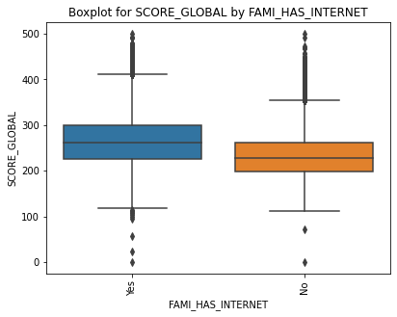
3. Data analysis
What about having computer? →
Demographic variable: Has internet
Having access to the internet is relevant.
On average, a student without internet has an overall score of 231.91 points, while one who has internet access has an average of 262.7 points. That’s 31 less points!

Slide 11

3. Data analysis
What about milk consumption? →
Demographic variable: Has computer
Having access to a personal computer is relevant.
On average, a student without computer has an overall score of 233.8 points, while one who has computer access has an average of 265.17 points.

Slide 12
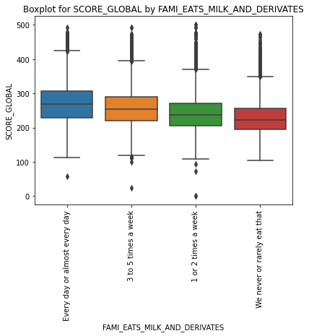
3. Data analysis
What about meat consumption? →
Demographic variable: consumption of milk and milk products
Students who never or rarely consume them obtained average scores of 227.75 points, much lower than the 268.67 of those who do consume them on a daily basis
Lowest results
Notes:
The level of consumption of meat, fish or eggs shows a differentiated behavior, evidencing that students who consume these products on a daily basis obtain better average (and median) results than those who do not consume them or those who do not do so in such a constant manner. The higher the consumption of these products, the better results are obtained in the 'Saber 11' test.

Slide 13
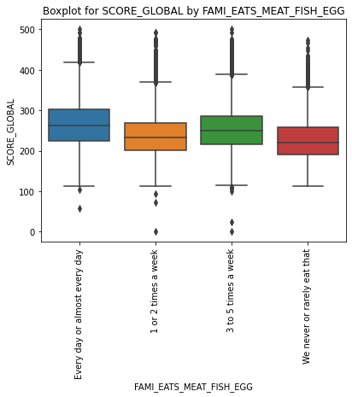
3. Data analysis
What about cereal consumption? →
Demographic variable: consumption of meat, fish and eggs
Students who never or rarely consume them obtained average scores of 227.29 points, much lower than the 264.0 of those who do consume them on a daily basis
Lowest results
Notes:
The level of consumption of meat, fish or eggs shows a differentiated behavior, evidencing that students who consume these products on a daily basis obtain better average (and median) results than those who do not consume them or those who do not do so in such a constant manner. The higher the consumption of these products, the better results are obtained in the 'Saber 11' test.

Slide 14
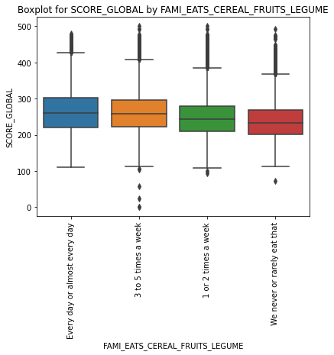
3. Data analysis
What about working hours? →
Demographic variable: consumption of cereal, fruit and legumes
Students who never or rarely consume them obtained average scores of 236.32 points, much lower than the 262.79 of those who do consume them on a daily basis
Lowest results
Notes:
As we have seen with the consumption of other foods, students who have a daily consumption of cereals and legumes also obtain better average results, in this case the difference seems to be smaller, but it exists and should therefore be taken into account when considering policies to support students.

Slide 15
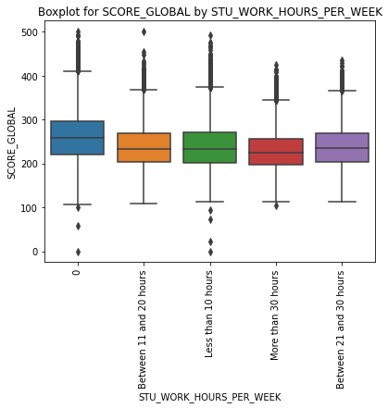
3. Data analysis
What about location? →
Demographic variable: student work hours per week
Students who work more than 30 hours a week have average scores of 228.28, that is about 32 points less than those who do not work.
Lowest results
Notes:
The fact that a student works has negative effects on the score obtained in the 'Saber 11' exam, those who do not have to work have average scores of 206 points but the group that works up to 30 hours a week, have an average score that ranges between 236.97 and 238.50 points, but even more critical, those students who work more than 30 hours a week have average scores of 228.28, that is about 32 points less than those who do not work.

Slide 16
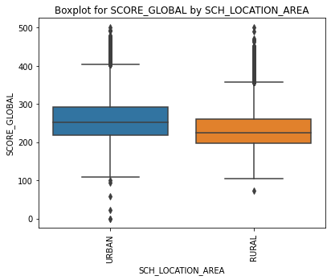
3. Data analysis
What about ethnicity? →
Demographic variable: school location area
Urban students have a better average performance, obtaining mean scores of 255.98 while rural students on average obtain 232.26
Notes:
We can see a difference in the results obtained between students who are from urban vs. rural schools, urban students have a better average performance, obtaining mean scores of 255.98 while rural students on average obtain 232.26. This means that there are differences in the population means of about 23 points in the overall score. Therefore, students living in rural environments should receive support from educational institutions in order to improve learning and obtain better results in the 'Saber 11' tests.

Slide 17
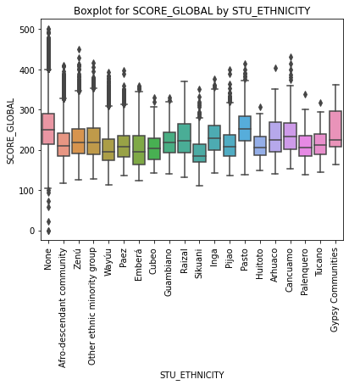
3. Data analysis
What about department location? →
Demographic variable: student ethnicity
The minority groups that present the lowest results, according to the average global score, are:
Sikuani global score mean: 194.48
Emberá global score mean: 202.59
Wayúu global score mean: 204.53
Cubeo global score mean: 206.66
Palenquero global score mean: 210.62
Notes:
As we can see in the boxplot and in the table of statistics, there are marked differences in the scores obtained by the students according to their ethnicity, the tendency is that students with an ethnicity have lower scores than those who do not (None), especially the minority groups that present the lowest results.
All minority groups, with the exception of the gypsy communities and natives of Pasto, have much lower scores than those without ethnicity (253.65 average points), so it is recommended to generate educational policies that focus on these groups, remembering that they represent about 6 percent of the total number of students.

Slide 18
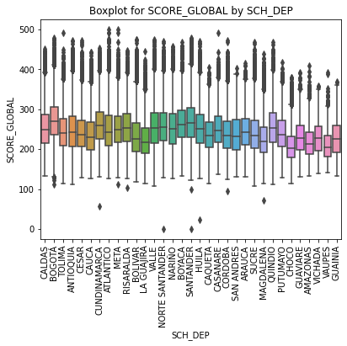
3. Data analysis
Recommendations →
Demographic variable: student ethnicity
The ten territories with the worst overall average results are listed below:
CHOCO: 208.79
VAUPES: 211.28
AMAZONAS: 219.20
LA GUAJIRA: 225.30
MAGDALENA: 226.71
GUAINIA: 228.32
VICHADA: 228.50
GUAVIARE: 231.04
BOLIVAR: 233.35
CAUCA: 236.28
Notes:
Looking at the results obtained by the department in which the school is located, we can see how the average performance of each of these was, in order to identify geographically the territories in which policies should be implemented in order to improve education and therefore the results obtained in the 'Saber 11' test.

Slide 19
4. Recommendations
The way to improve the results obtained by students in the Saber 11 test, is through the application of policies that seek to address the population subgroups that have lower performance, as well as the attention to factors that affect student performance, guided by the points listed below:
It is necessary to prioritize educational policies that help students in subjects such as Social Sciences, English and Natural Sciences, due to the fact that these have the lowest average scores in the Saber 11 test in the last three years (2018, 2019 and 2020).
Special attention should be paid to students whose parents have not completed high school, since this group obtains worst average results than students whose parents have at least completed high school.
It can be said that the students who need more support are those of the irregular shifts Sabatine and night, but that a change in student policy is advisable to adopt the full day at the national level, since they are the students who have the best results in average in the 'Saber 11' tests.
We can indicate that students without internet access have worse average results than those who have internet at home, so education policies should encourage the use of internet for educational purposes and expand national coverage, that in this moment is estimated to be the 64 percent of the students.
Policies that help students to have access to computers in schools or public policies that facilitate the purchase of these appliances by families should be created, access to computers by students at home is estimated at 60%

Slide 20
4. Recommendations
Policies should focus on students who do not consume milk, milk products, meat, fish, eggs, cereals and legumes on a daily basis, as well as on the inclusion of these foods in school diets and on facilitating access to these types of foods in the basic basket of families, since there are differences in average global scores with peers who do.
The fact that a student works has negative effects on the score obtained in the 'Saber 11' exam, so efforts should be focused on students who work, even more so if they work more than 30 hours a week.
Students living in rural environments should receive support from educational institutions in order to improve learning and obtain better results in the 'Saber 11' test, this group of students have a lower global score that the urban students.
All minority groups, with the exception of the gypsy communities and natives of Pasto, have much lower scores than those without ethnicity (253.65 average points), so it is recommended to generate educational policies that focus on these groups, remembering that they represent about 6 percent of the total number of students.
Students located in the next departments should be the focus of policies to improve their education, this have the lowest mean global scores: Choco, Vaupes, Amazonas, La Guajira, Magdalena, Guainía, Vichada, Guaviare, Bolivar and Cauca. In this group, departments such as Choco, Vaupés and Amazonas stand out for their low performance.
It is advisable to generate educational support policies for students who do not report stratum and those who belong to stratum 1 and 2, these three groups are the ones that historically have the lowest performances.

Slide 21
5. Further exploration
An exploratory data study has been conducted, statistically describing differences between subgroups of students, as the data are from the population of students who took the exam in 2018, 2019 and 2022 and not a sample. However:
A supervised classification model can be created, aided by Machine Learning algorithms, to generate a model to establish which students are at risk to fail and to be able to take measures prior to taking the Saber 11 exam.

Slide 22

6. Questions

Slide 23
Thanks!

